Slide 1
Pandemic Strategy: Tracing & Containment Architecture
Outbreak/ Epidemic Traceability & Containment Architecture

Slide 2
Key Stages & Components
Tracing
Leverage data & movement
Containment
Minimize Flatten Curve
Testing
Strategic & Granular
Leverage Tracing data; Infection Clusters & Medical algorithms
Research
Pathology, Detection, Medicine, Vaccine
Treatment
Grow Capacity, Speed

Slide 3
Tracing & Containment: Why?
Tracing on the ground?
Seems to be manual inquiry based
Data tracking system?
“challenges of community tracing in a dense slum where over 23,000 people are huddled in less than a 1 sq km”
Tracing who the help met over 10 days in the vast slum since she was first exposed to coronavirus is proving to be difficult, but what health workers find impossible is to trace each woman who used the public washroom where she bathed every day.
The Epidemic Diseases Act of 1897 gives special powers to state governments. India’s Narendra Modi government has already advised states to use it to make their coronavirus advisories more stringent.
This law enables states to ban public gatherings, ask schools and large institutions to stop functioning, and issue advisories to companies to explore work-from-home models. It also gives the state a right to penalise media organisations spreading misinformation.
Dr Nutan Mundeja, Director, Directorate General of Health Services (DGHS), said the task force is calling all flyers who have arrived here, in the last 14 days, from virus-affected countries, twice a day to know if there have developed symptoms. Symptoms show during this 14-day period.
"First we only had their addresses. Now we also have their phone numbers," she said.
The task force, headed by CM Arvind Kejriwal, has so far put 1,40,603 screened flyers on surveillance. It also comprises the civic body and police officials.
A man, the first positive case of COVID-19 from the Capital with a travel history in virus-affected Italy reported on March 2, sent authorities on a wild goose chase as they tracked the number of people he had come in contact with.
A health scare was sparked next day after it was revealed that the man had met several people, including at a birthday party he threw at a five-star hotel in Delhi on February 28 for his child, triggering fears that the students at the Noida-based school who attended it might be at risk. More-or-less similar situations have been seen in the other two cases.
"I request everyone if you know any person who has just returned from abroad, inform the Delhi government. Our team will get in touch with them and put them on surveillance after some general investigation," the CM said.
National Disaster Management Act of 2005 (NDMA)
The government has also asked people with a travel history to coronavirus-affected countries to report to nearest government hospital.
If a coronavirus case is reported from a defined geographic area such as village, town, ward, colony, settlement, the district administration of the district concerned shall have the right to implement containment measures, including sealing of the area, barring entry and exit of population from the containment area, closure of schools, offices and banning public gatherings, besides other measures.

Slide 5
Real Time Visualizations
Spatio Temporal Intersections
Infection Trees over time
Branches over time
Multiple branches
Branches of
Denser Clusters
More Nodes
Infection Trees over area
Intelligent & Informed Targeting on Ground

Slide 6
Examples

Slide 7
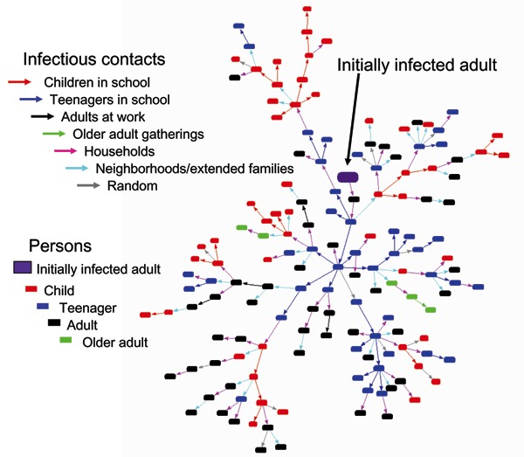
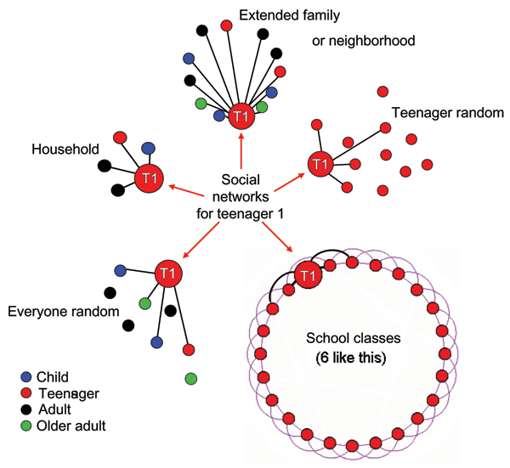
Epidemics & Outbreaks

Slide 8
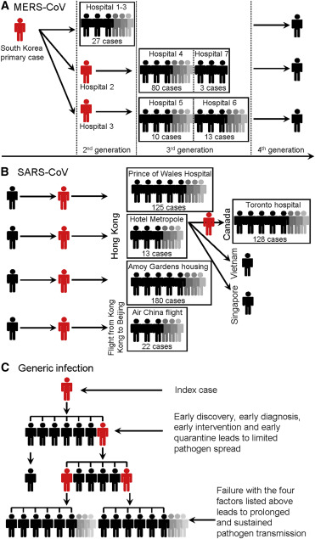
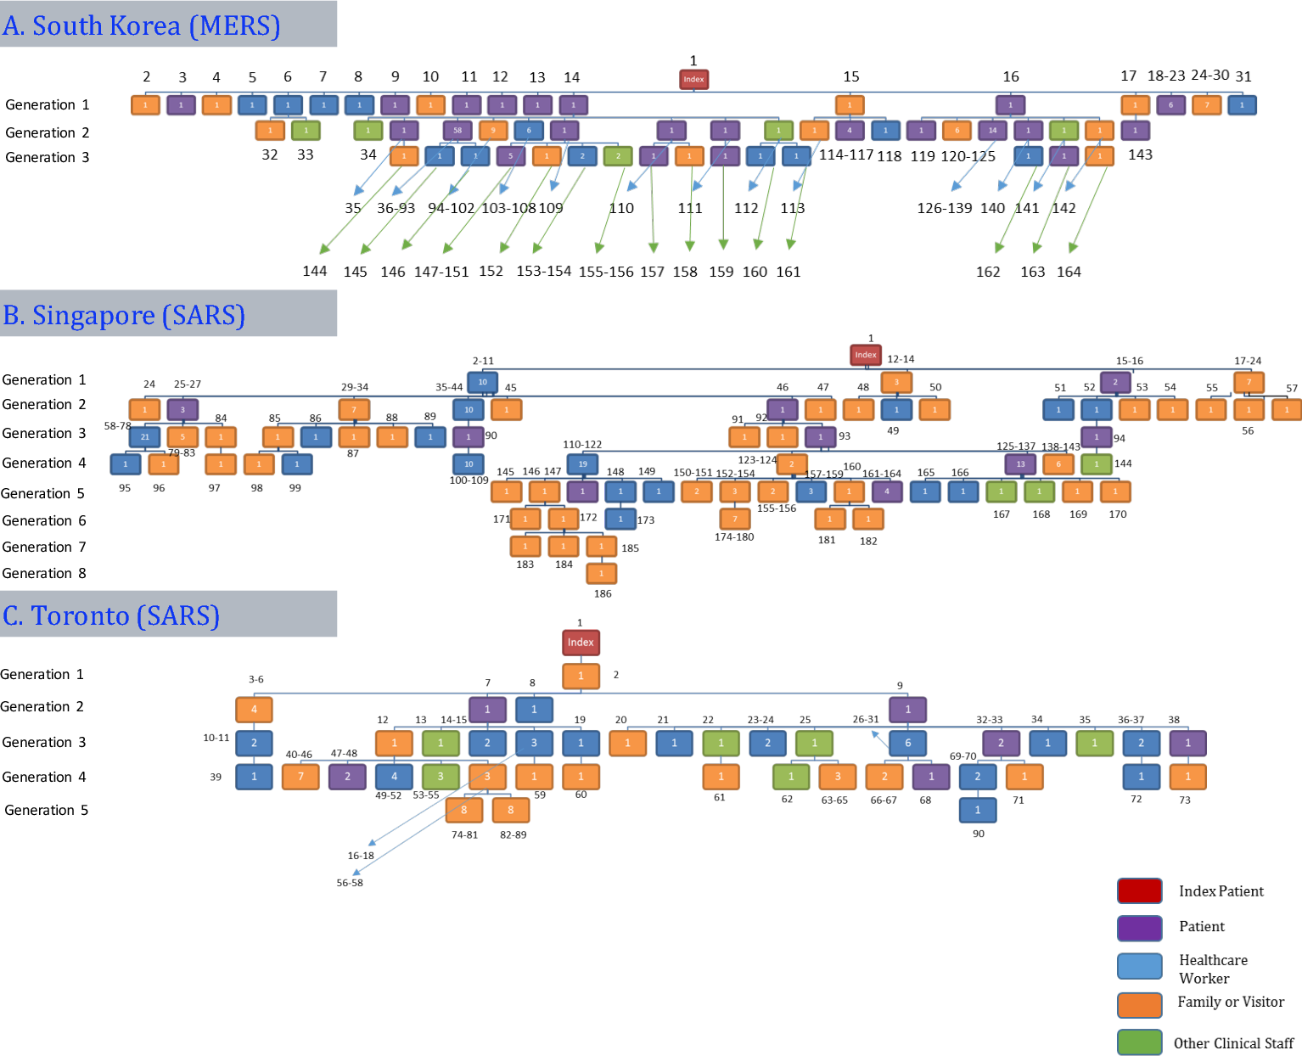
Epidemic Comparison

Slide 9
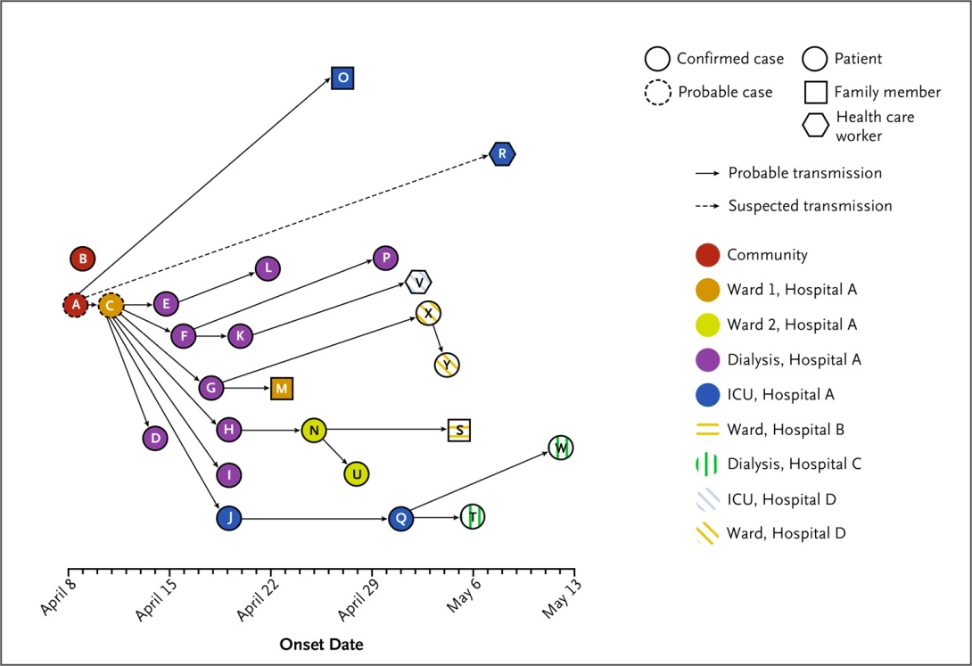
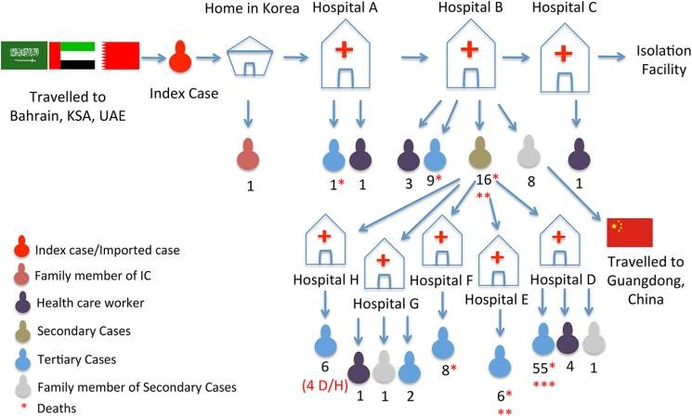
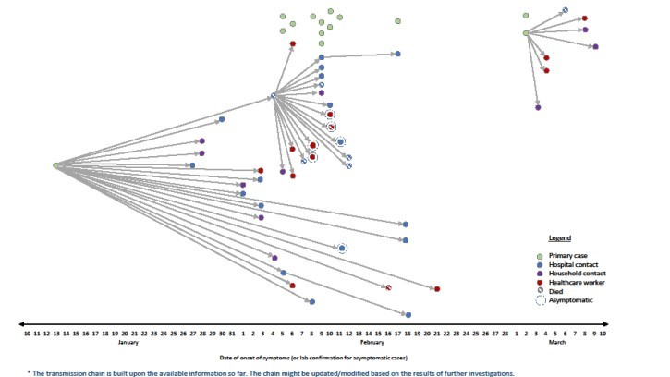
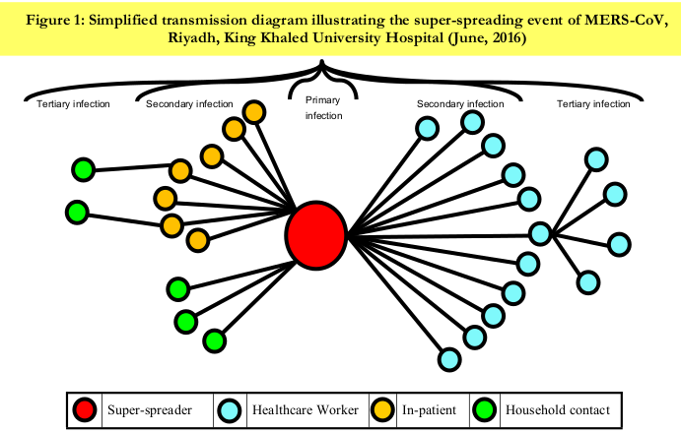
Force Vector Diagram /Network Graph to track infection nodes
Force Vector Diagram or Network Graph
http://dj.kbs.co.kr/resources/2015-06-04/

Slide 10
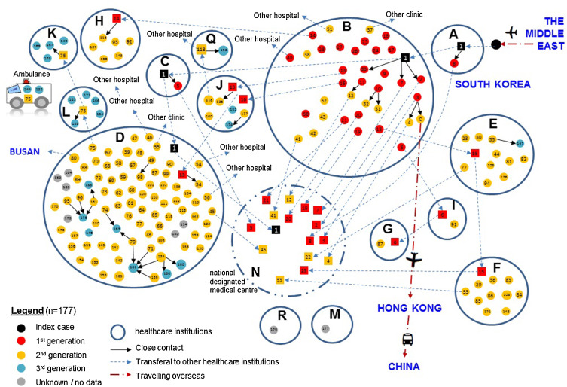
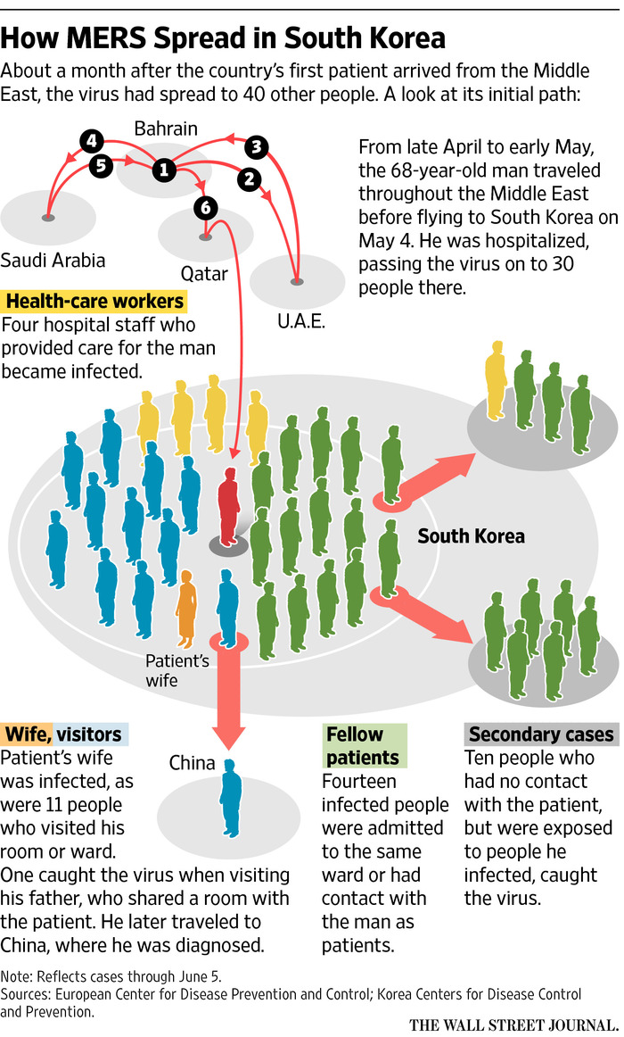
MERS

Slide 11
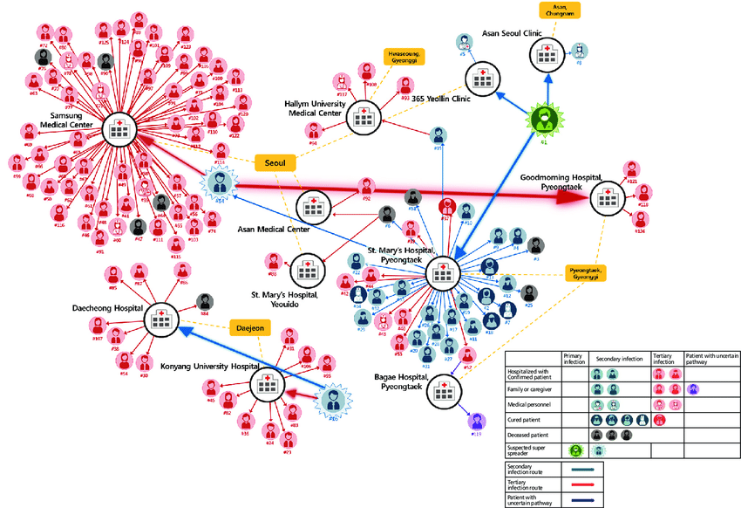
Dynamic Data Views

Slide 12
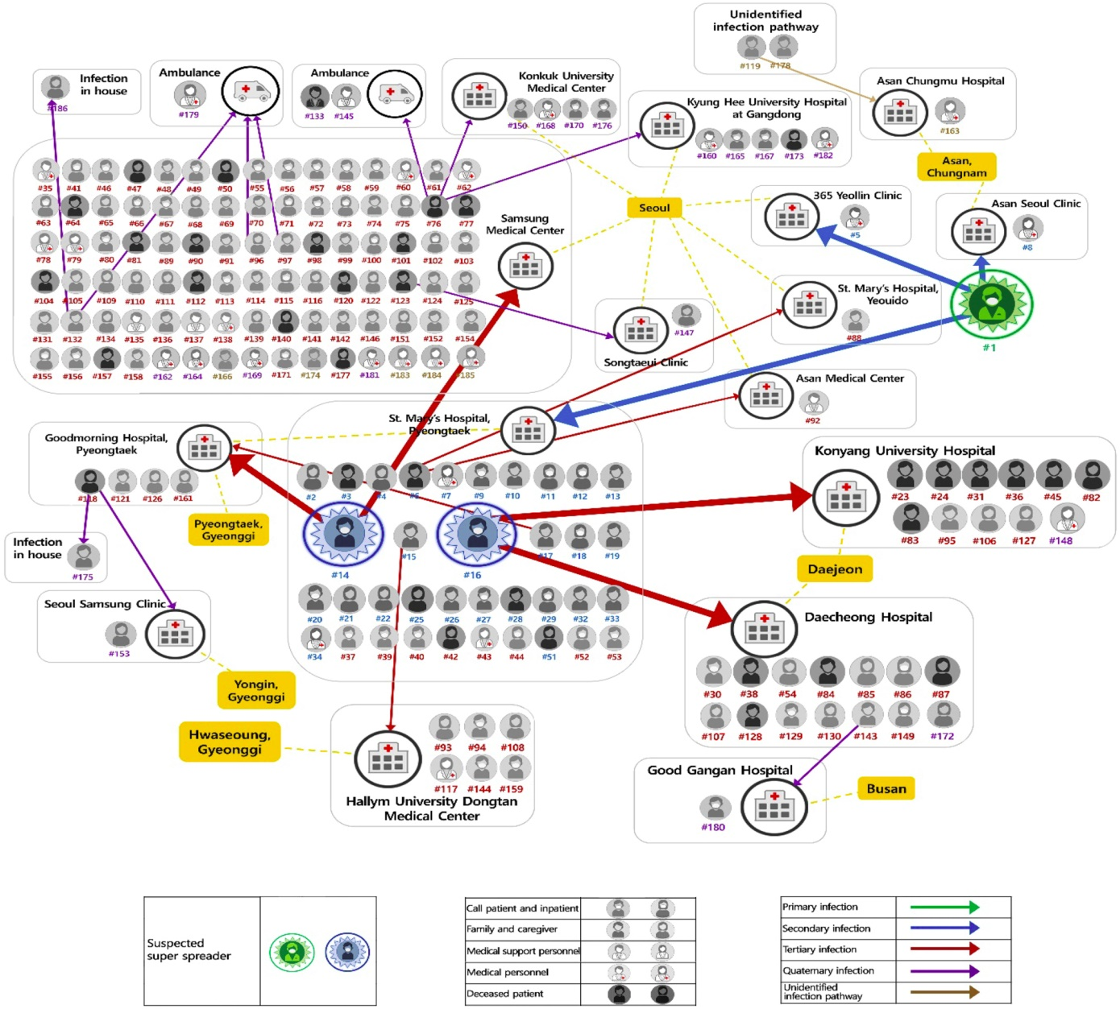

Slide 13
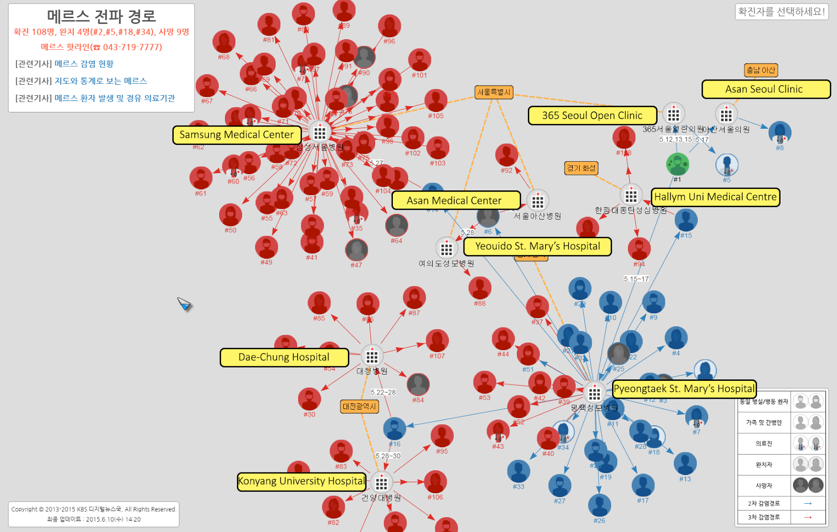
Data Viz Tool

Slide 14
MERS Korea – Animated Story
https://www.sciencenews.org/article/anatomy-south-korean-mers-outbreak
Data driven Network Graph model/ tool
http://dj.kbs.co.kr/resources/2015-06-04/

Slide 15
Process
Visualize Knowns
Locations & Spatio Temporal Pathways - K
Tracing Unknowns
Map “mobile unknowns” that cross Knowns - U
N-degrees of Separation – Keep iterating
Intersections & Associations
Visualize N-degrees of “suspects: branches & clusters”
Map “suspects” to Geo locations for Heatmaps
Link to Numbers & Push-Pull people info as needed
Infection timelines; days, symptoms, condition status
Various ways to tweak, tune & manipulate the Network Graphs to Visualize & Query
Provides basis for well informed decisions, granular actions
Testing, Containment, Resource plans/ allocs for Security & Treatment
Timelines -

Slide 16
Visualize Known

Slide 17
Tracing Unknowns

Slide 18
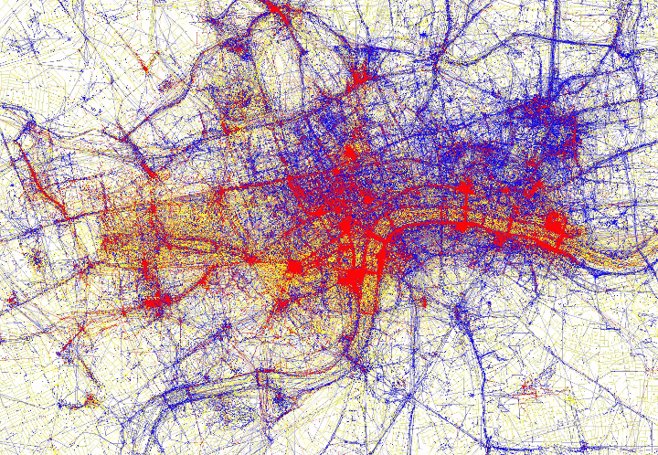
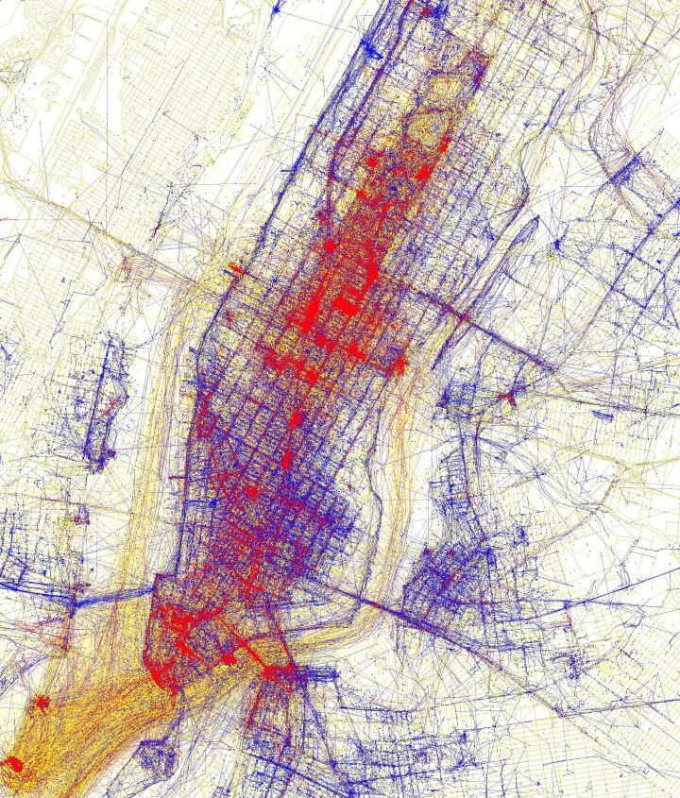
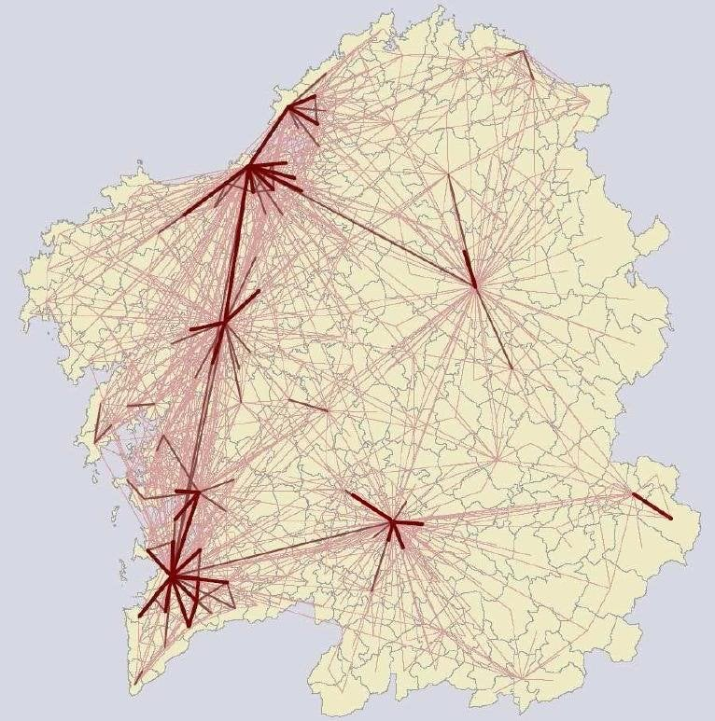
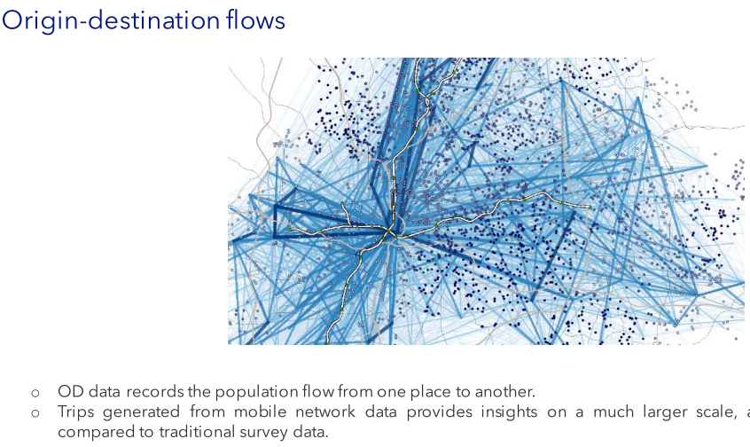
Human Mobility Patterns & Pathways
Timestamp everything
Mobility Intersections
Social Contacts
Trips generated from mobile network data provides insights on a much larger scale, and with greater reliability as compared to survey data.

Slide 19
People Intersections
Determine Spatio-Temporal Intersections
Location & Movement Data & Pathways
Telcos
Mobile movement - Cell, Tower, HLA logs -
Phone Hardware & OS Logs
App Logs; Whatsapp, FB, Uber, Ola, Insta etc.
Manual data – via authorities; Medical, Security, Administrative
Intersections with People/ Nodes & weighted ranking
Positive, Quarantined, Import, Local, Associated, Suspect, Possibility,
Speed & Time overlap, Pedestrian vs Vehicular
Various trees, branches & sub branches
Granular & Targeted determination of Suspect Clusters
Better tracing, containment & testing strategy & efforts

Slide 20
Personnel/ Team
Academia
Startup & Tech community
Complex Data Visualization
Data Science
Network Graph & Query
Weighted network nodes
Bio Informatics
Urban Mobility & Density
Complex Data Visualization
Data Science
App & client side UI
Location, LDD, Pathway
Shared Mobility & Pooling

Slide 21
Testing: Bulk vs Surgically Targeted

